Slide 1
Example-Based Stylization of Navigation Maps on Mobile Devices
Ondřej Texler
Daniel Sýkora

Slide 2
Preview

Slide 3
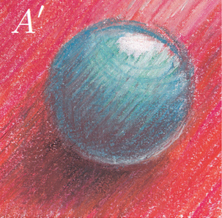
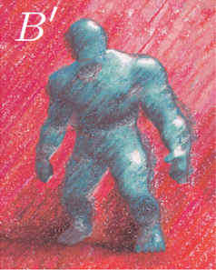
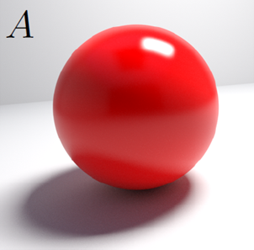
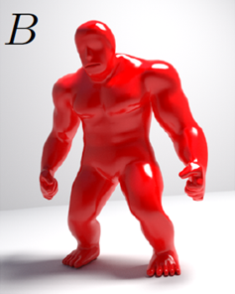
Recent Work
Example-Based vs. Procedural
[Fišer et al. 2016]
[Montesdeoca et al. 2016]

Slide 4
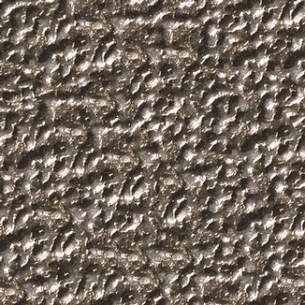
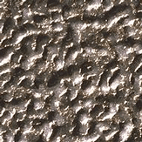
Recent Work – Neural Texture Synthesis
[Gatys et al. 2015]
=
Deep Neural Network
=

Slide 5
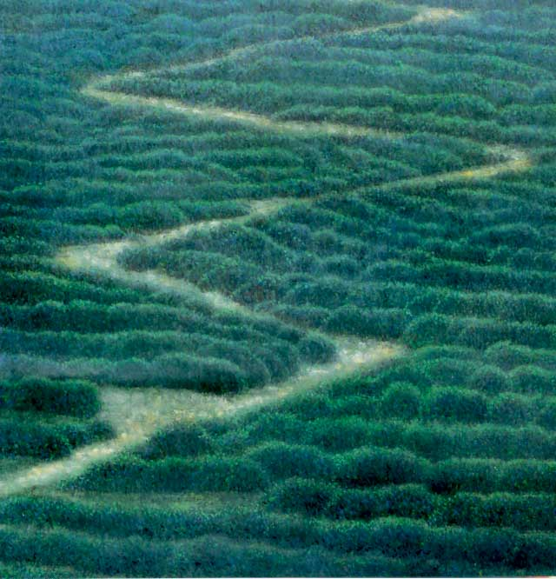
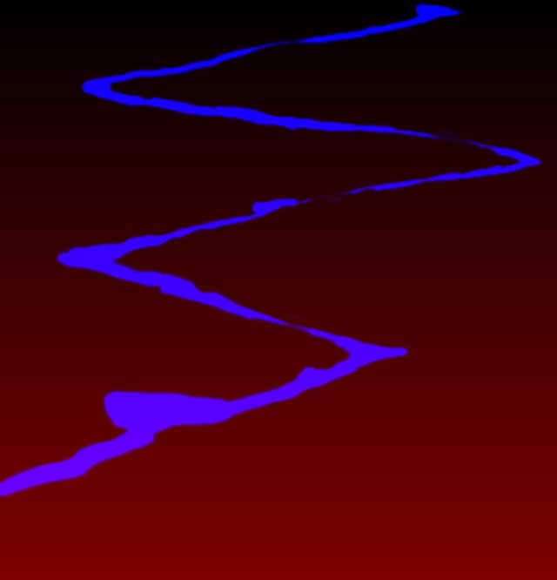
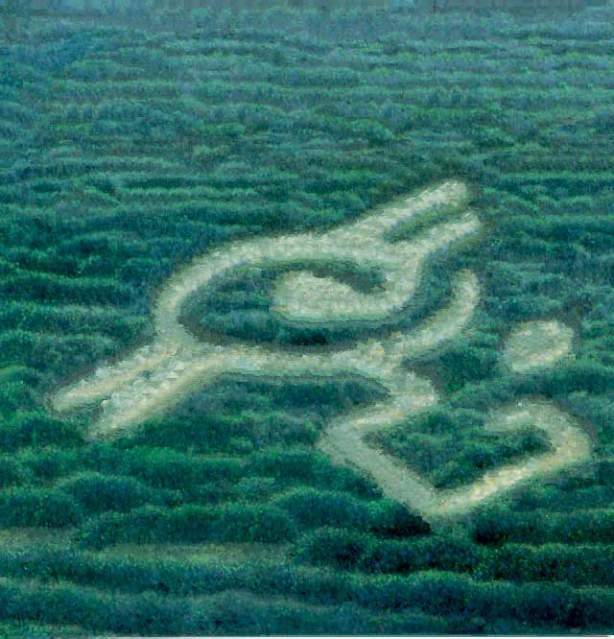

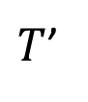

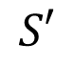
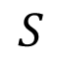
Recent Work – Guided Texture Synthesis
Image Analogies
$$S$$
$$S′$$
$$T$$
$T$’
[Hertzmann et al. 2001]

Slide 6
Map Stylization – Use Case
Sample Guide
Sample Style
Output Guide
Output

Slide 7
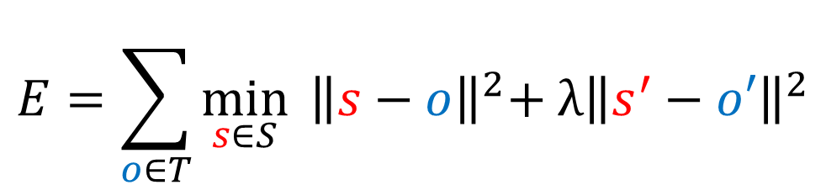
Texture Synthesis – Navigation Maps
$$E=\sum_{o∈T}{\min_{s∈S}{{ \left\|s−o\right\|}^{2}+{ λ\left\|s^{′}−o′\right\|}^{2}}}$$
NNF
Sample Guide
Output Guide
1
2
3
Sample Style
4
5
6
VOTING

Slide 8
Pre-synthesized speed-up
Significant speed improvement
Output Guide
Initialization
Building
texture
Water
texture
Small road
texture
Mask
Output
Large road
texture
Grass
texture

Slide 9
Pre-synthesized speed-up – result quality
0px mask
4px mask
8px mask
Full image
Almost instant
65x faster
30x faster

Slide 10
CNN Approaches Comparison
Style
Deepart.io
Artistic Style
Ours

Slide 11
CNN Approaches Comparison
Style
Deepart.io
Ours

Slide 12
Results - Infinite zooming
Original zoom
150% zoom
200% water
200% road

Slide 13
Conclusion
Take-Home message
Stylization may be interesting not only for artists with GTX 1080Ti
Summarization
Idea of navigation map stylization
Overview of Texture Synthesis and Stylization approaches
Stylization algorithm, Pre-Synthesized speed-up, Results and comparison
Limitations and Future Work
Still not fast enough (PatchMatch)
Method to handle more complex styles (shading)

Slide 14
Thank you for your attention!
Q&A

